Slide 1
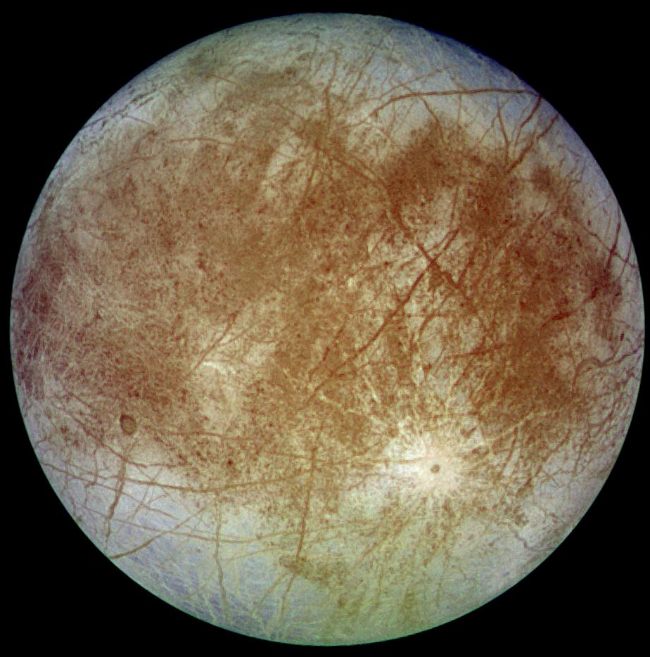
Europa
Radius:
1,560.8 km
Discovered in 1610 by Galileo Galilei
Orbital Period:
3.55 Earth days
Mass: 4.7x10²² kg

Slide 2
Europa
Missions that have explored this moon include the Voyager and Galileo missions. The Hubble Space Telescope has also provided valuable data in the study of this moon. Additionally, Earth based studies, such as gathering spectrographic data to measure water vapor above Europa has been done at the Keck Observatory. These studies have put Europa on the list of places in our Solar System that might contain life. Scientists believe the moon is surrounded by a thick shell of ice with a warmer, saltwater ocean underneath. How thick this ice layer is, is an ongoing question. The composition of this ice layer is also unknown, as more compounds than water can freeze at the low temperatures this far from the Sun. The temperature of the water under the ice shell could provide insight into locations of potential hydrothermal vents, which we know to harbor life on Earth.

Slide 3
Europa
1. Voyager and Galileo missions. Hubble Space Telescope
2. Water-rich and warm interior could be hospitable to life
3.
4. almost the size of Earth’s Moon.
https://space-facts.com/moons/europa/
Magnetic field exists, meaning conductive beneath ice (salt water)
https://solarsystem.nasa.gov/moons/jupiter-moons/europa/in-depth/
Spectrograph at Keck Observatory to measure water vapor above Europa. Infrared light emit or absorb.
Ice shell probably 15-25 km thick.

Slide 4
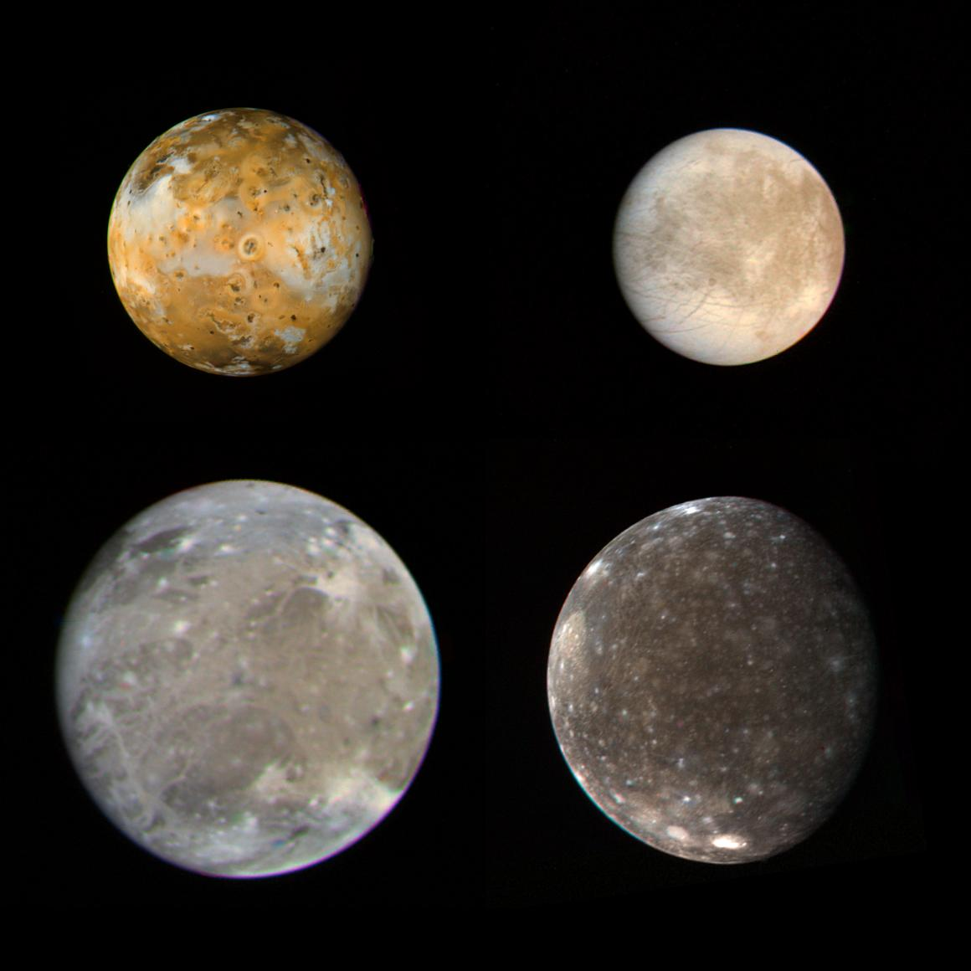
Io
Radius:
1,821.6 km
Discovered in 1610 by Galileo Galilei
Orbital Period:
1.77 Earth days
Mass:
8.9x10²² kg

Slide 5
Io
Multiple missions have explored Io, including Voyager, Cassini, Galileo, and New Horizons. Io is the most volcanically active body in our Solar System, with over 400 volcanoes. These volcanoes can produce plumes of sulfur, sulfur dioxide, and rocky ash up to 200km high! There are many volcanic features on Io, including lakes of molten silicate lava. Some biochemical theories propose silicon as an alternate chemical to carbon, meaning there could be alien silicon-based life that looks very different from our world of carbon-based life. Could some evidence of a new form of life exist on this hazardous moon?

Slide 6
Io
1. Voyager, Cassini, Galileo, New Horizons
2. most volcanically active body in the solar system. >400 active volcanoes
3. volcanic plums up to 200hm high, sulfur, sulfur dioxide, rocky ash
4.
https://space-facts.com/moons/io/
https://en.wikipedia.org/wiki/List_of_volcanic_features_on_Io
https://solarsystem.nasa.gov/moons/jupiter-moons/io/overview/
Lakes of molten silicate lava

Slide 7
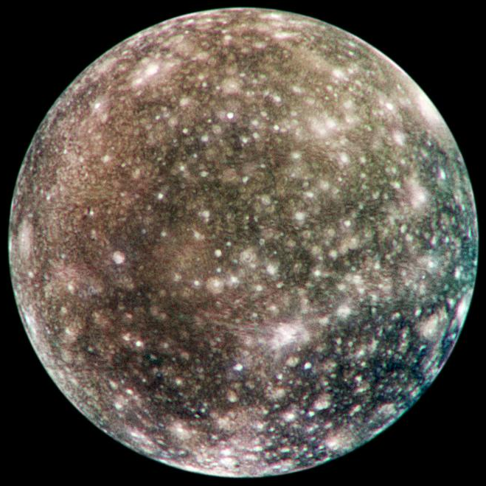
Callisto
Radius: 2,410.3 km
Discovered in 1610 by Galileo Galilei
Orbital Period:
16.69 Earth days
Mass:
10.8x10²² kg

Slide 8
Callisto
Many missions have explored Callisto, including Pioneer, Voyager, Galileo, Cassini, and New Horizons. Callisto is about the size of Mercury and has the most heavily cratered lunar surface in our Solar System. The surface has water ice, CO₂ ice, silicate dust, rock particles, and hydrocarbon compounds. Oxygen has been found in the exosphere. These compounds indicate a potential for life being found on Callisto. It is also suspected that Callisto has a subsurface ocean, like some of Jupiter’s other moons. A topographical map of the heavily cratered surface could aid in establishing a location to drill into the crust. Samples from the surface would provide insight into other compounds that exist around the planet, which would help us model the moon’s environment on Earth. Astrobiologists model extraterrestrial environments to test for the formation of materials we associate with life.

Slide 9
Callisto
https://space-facts.com/moons/callisto/
Surface has water ice, CO2 ice, silicate dust, rock particles, hydrocarbon compounds. Interior ocean.
Most heavily cratered surface of a world in the solar system
Missions that have explored Callisto: Pioneer, Voyager, Galileo, Cassini, New Horizons
https://solarsystem.nasa.gov/moons/jupiter-moons/callisto/in-depth/
About the size of Mercury
Suspected subsurface ocean – potential for life. Oxygen detected in exosphere

Slide 10
Ganymede
Radius:
2,631.2 km
Discovered in 1610 by Galileo Galilei
Orbital Period:
7.15 Earth days
Mass:
14.8x10²² kg

Slide 11
Ganymede
Ganymede has been studied by the Voyager, Galileo, Pioneer 10, Juno, and New Horizons missions. It has also been viewed with the Hubble Space Telescope. This moon is the largest in our Solar System, even bigger than the planet Mercury! It is also the only moon with its own magnetosphere. Scientists suspect it is caused because the moon may have a nickel core with a liquid iron layer surrounded by a subsurface ocean and an extremely thick ice shell. The magnetosphere causes colorful auroras around the moon, similar to the Northern Lights on Earth. Despite the moon being smaller than Earth, it is possible that it contains more water than all of Earth’s surface combined.

Slide 12
Ganymede
1. Hubble Space Telescope, Pioneer 10, Voyager, Galileo, New Horizons, Juno
2.
3.
4.
https://space-facts.com/moons/ganymede/
Largest moon in the solar system, larger than Mercury.
Strong magnetosphere so thought to have subsurface ocean over liquid iron and nickel core
https://solarsystem.nasa.gov/moons/jupiter-moons/ganymede/in-depth/
Only moon with it’s own magnetic field. auroras – glowing electrified gas
Underground saltwater ocean suspected. More water than all Earth’s surface.
Thick ice shell about 800km thick.

Slide 13
References
Io and Ganymede- https://pds-rings.seti.org/press_releases/pages/PIA00xxx/PIA00023.html
Europa - https://pds-rings.seti.org/press_releases/pages/PIA00xxx/PIA00502.html
Callisto - https://pds-rings.seti.org/press_releases/pages/PIA03xxx/PIA03456.html
https://nssdc.gsfc.nasa.gov/planetary/factsheet/joviansatfact.html

Slide 14
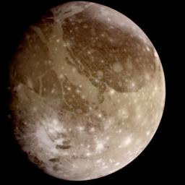
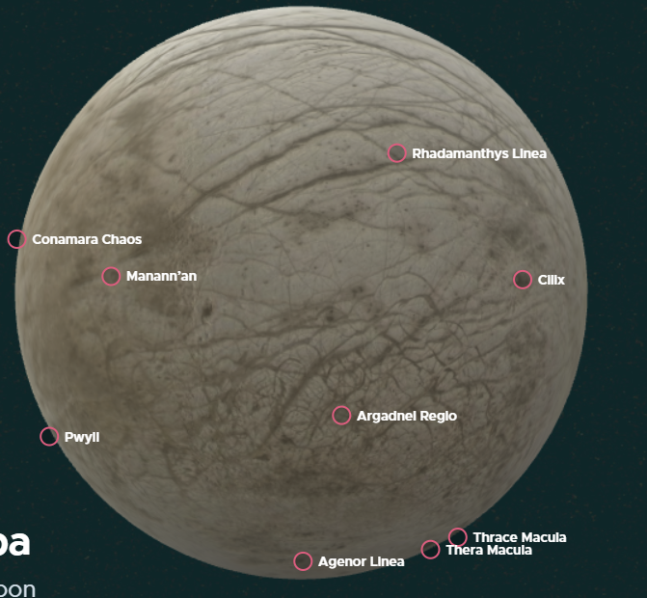
option
Ganymede - https://pds-rings.seti.org/press_releases/pages/PIA00xxx/PIA00716.html
https://solarsystem.nasa.gov/moons/jupiter-moons/europa/in-depth/

Slide 15
Background
1. Missions that explored the moon (edit this to be chronological)
2. fact relevant to game mission
3. fact relevant to game mission 2
4. fun fact

Slide 16
Jupiter
https://solarsystem.nasa.gov/moons/jupiter-moons/europa/in-depth/
Jupiter takes 4,333 Earth days to orbit the Sun
Jupiter’s moons Io, Europa, and Ganymede are in what is called a resonance – every time Ganymede orbits Jupiter once, Europa orbits twice, and Io orbits four times
Callisto, (and others) tidally locked so same side always facing Jupiter
Strong magnetic field to consider
These 4 Jovian moons were the first moons discovered orbiting a planet other than Earth. Led to heliocentricism.
https://image.gsfc.nasa.gov/poetry/venus/q89.html
43 minutes for sunlight to reach Jupiter
Other Link

